Slide 1
EE185524 Sistem Pengaturan Berjaringan (2 sks)
Yurid Eka Nugraha
TSP DTE FTEIC ITS

Slide 2
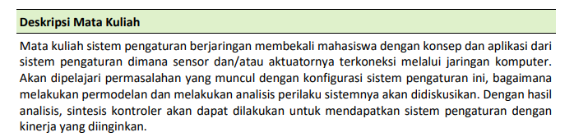
Deskripsi mata kuliah
(Kurikulum 2018 DTE ITS)
EE185524 2022E – 0

Slide 3
Deskripsi mata kuliah
(Kurikulum 2018 DTE ITS)
EE185524 2022E – 0

Slide 4
Topik/pokok bahasan
Konsep dan arsitektur sistem pengaturan berjaringan
Jenis-jenis sistem pengaturan berjaringan
Komponen-komponen sistem pengaturan berjaringan
Permasalahan pada sistem pengaturan berjaringan
Estimasi pada jaringan dengan kehilangan data
Analisis sistem pengaturan berjaringan
Perancangan sistem pengaturan berjaringan
Aplikasi sistem pengaturan berjaringan
EE185524 2022E – 0

Slide 5
Rencana perkuliahan (sangat tentatif)
Minggu ke-:
Introduction and overview
Introduction and overview
Linear system with delay
Nonlinear system with delay
Nonlinear system with delay
Identification and estimation of delayed system
Dead time
Midterm
Sampling theory
Information theory
Quantized system
Stabilization of delayed system
System over networks/Paper presentation
Paper presentation
Paper presentation
Final exam
EE185524 2022E – 0

Slide 6
Referensi
F-Y. Wang and D. Liu, Networked control systems: Theory and applications, Springer, 2008
A. Bemporad, M. Heemels, and M. Johansson, Networked control systems, Springer, 2010
Research papers related to NCS
EE185524 2022E – 0

Slide 7
Komponen penilaian
Tugas: 30%
ETS: 20%
EAS: 25%
Project (Review paper+presentasi): 25%
Ketidakhadiran <= 25% untuk lulus
EE185524 2022E – 0

Slide 8
Lain-lain
Dosen:
Yurid Eka Nugraha
AJ-104/B105(?)
yurid@its.ac.id
Materi perkuliahan diupload di myITS classroom
EE185524 2022E – 0

Slide 10
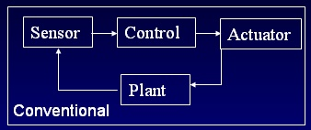
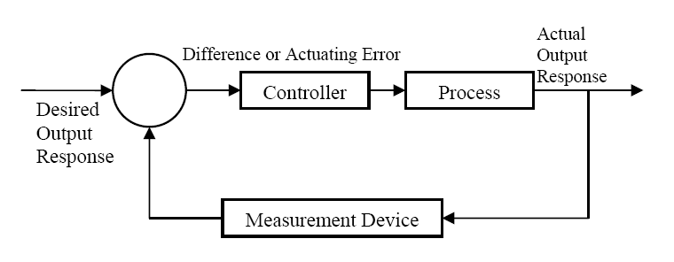
NCS architecture
Networked control systems where the sensors, controller and actuators of a digital controller reside on different computer nodes linked by a network
Data delay and loss on the network may jeopardize stability
EE185524 2022E – 1

Slide 11
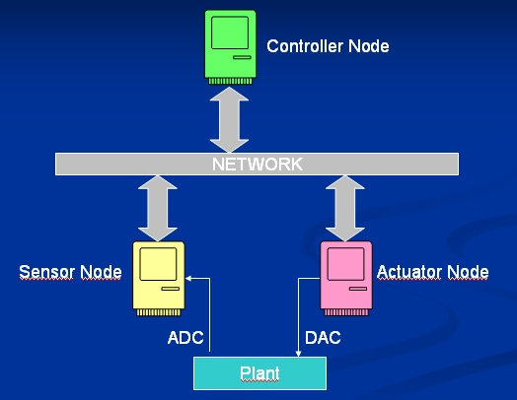
NCS Architecture
This structure depends on a single computer to calculate the control algorithm. Depending on the complexity of the plant, it may be too complicated. We come across a computational bottleneck.
The plant may be physically large: signals need to travel long distances to the control computer, causing noise.
Long connections: difficulty in maintenance and troubleshooting.
The control system is not flexible; adding new sensors, actuators to the system and changing the control algorithm would be major tasks.
EE185524 2022E – 1

Slide 12
NCS Architecture
The communication network brings along (usually) unpredictable delays
It also introduces possibility of data loss and corruption.
It is not clear how to separate the control algorithm into parts. Some control systems are not suitable for such separation.
EE185524 2022E – 1

Slide 13
Control Strategies
Decentralized
Centralized
Multilevel
Distributed
EE185524 2022E – 1

Slide 14
Multi-Level
Subsystem S1
Subsystem S2
EE185524 2022E – 1

Slide 15
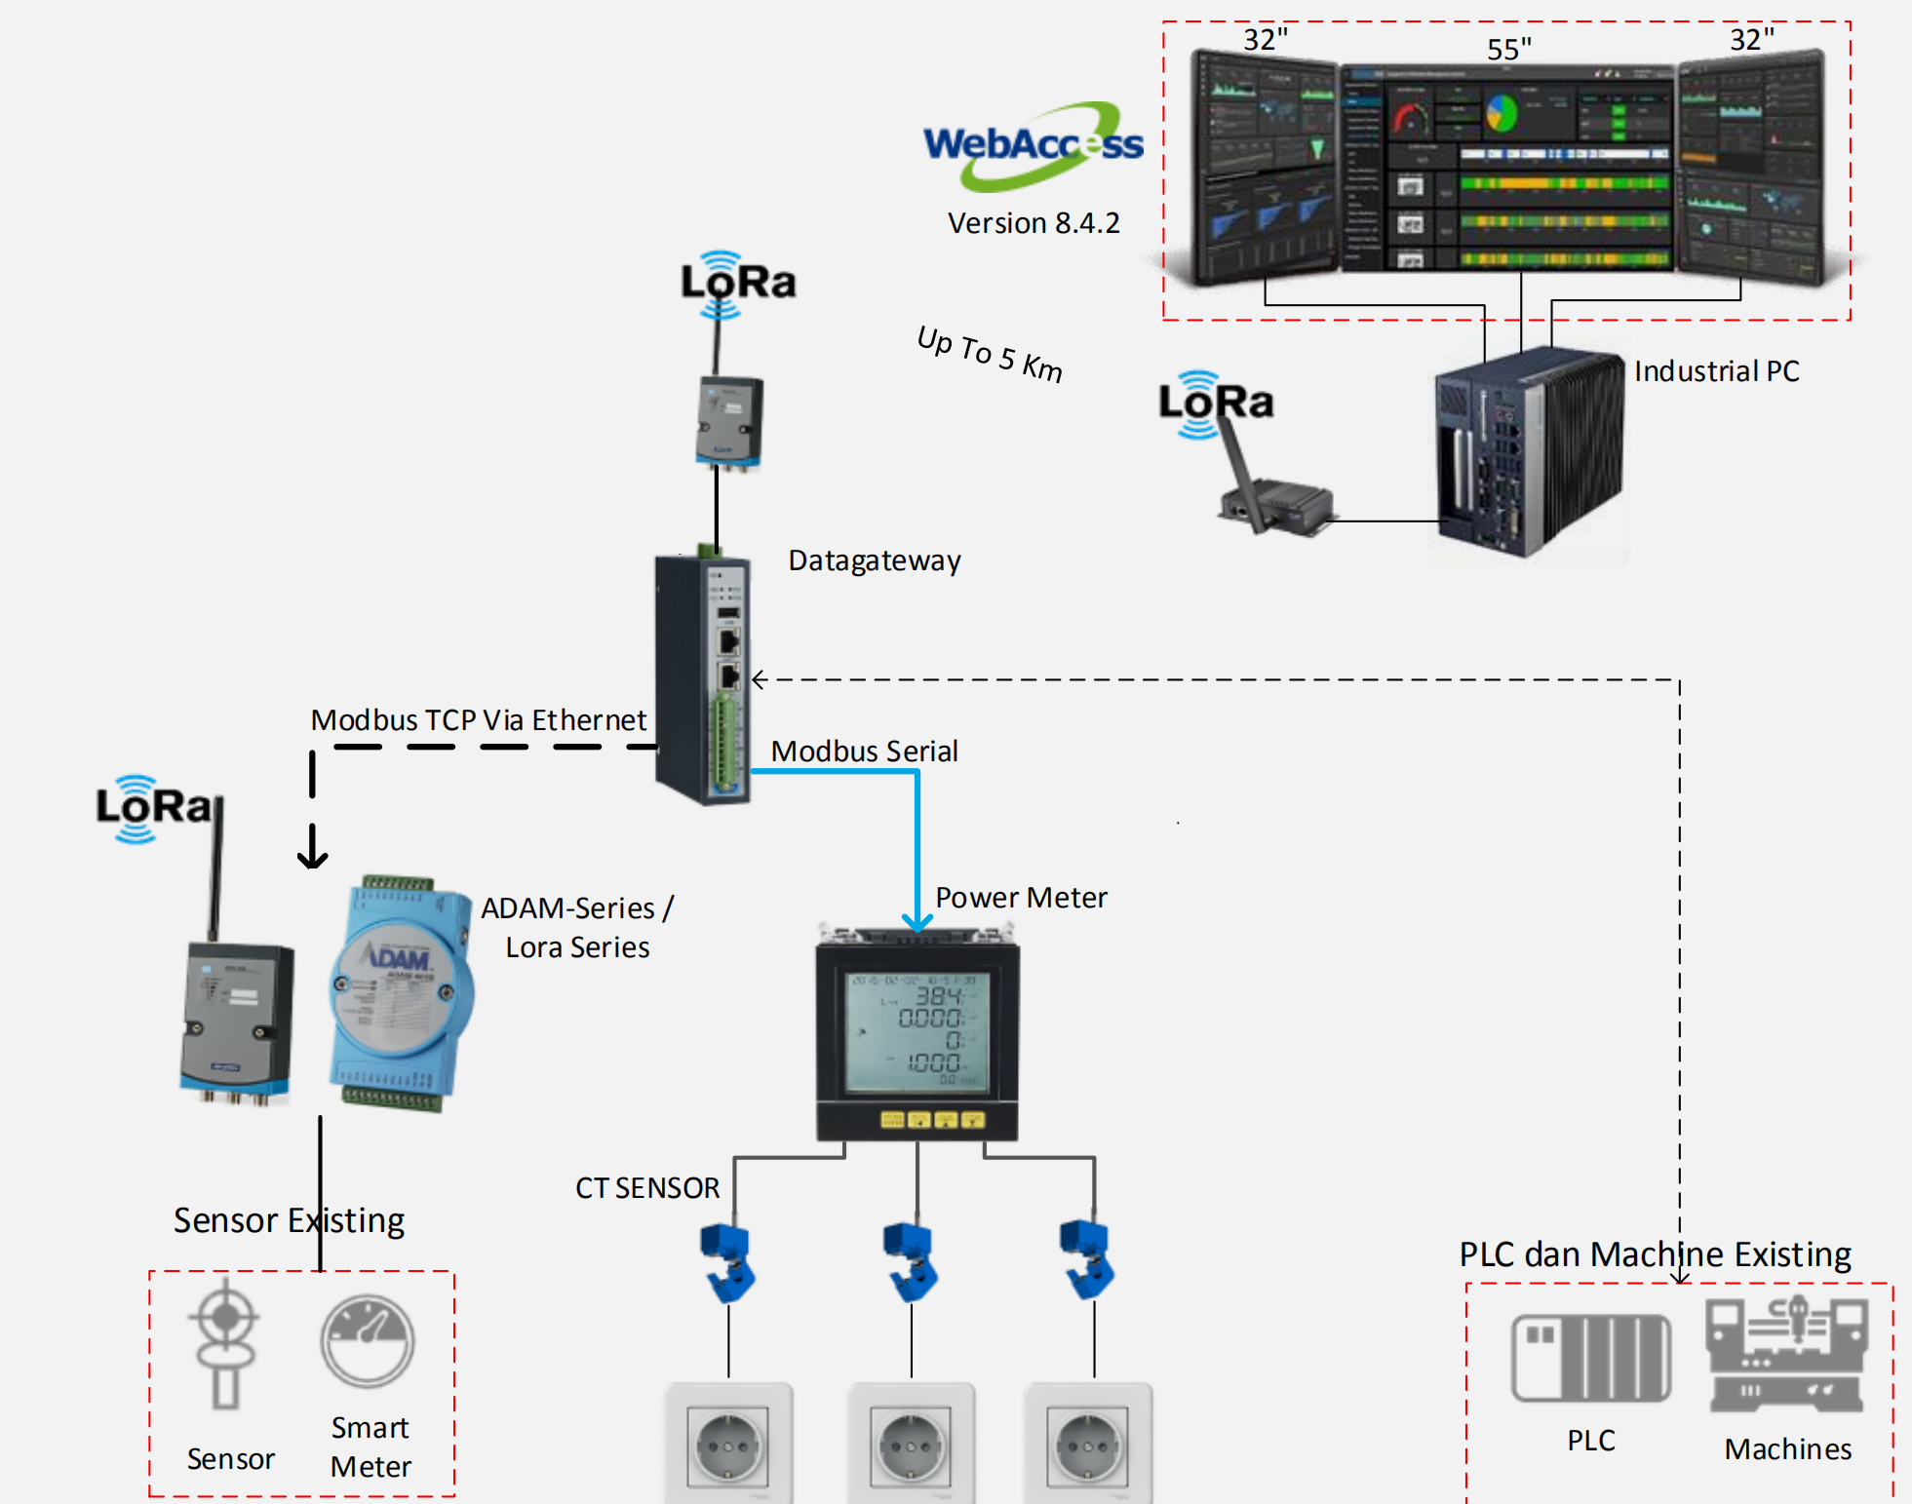
NCS Architecture
EE185524 2022E – 1

Slide 16



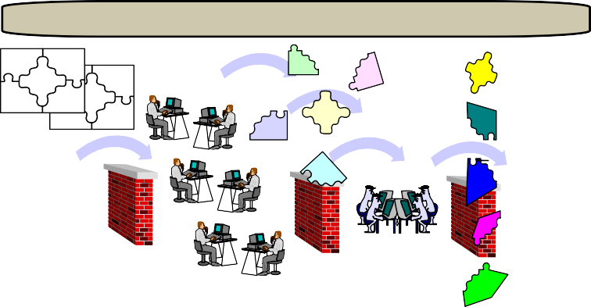

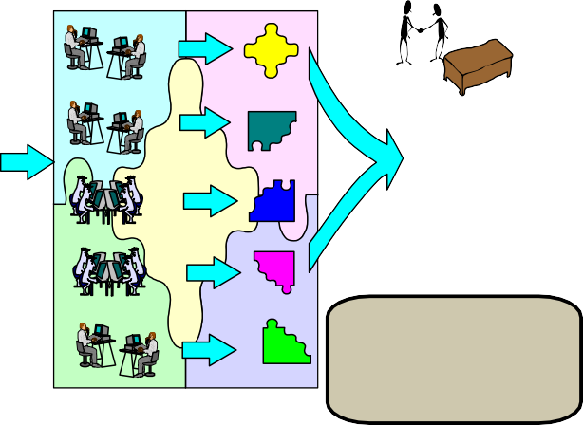

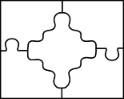





Desired Development Process
Typical Software Development Process
Manual, Paper Intensive, Error Prone, Resistant to Change
Model-Based System Engineering
Predictive Analysis Early In & Throughout Life Cycle
Little Insight
Requirements Analysis
System Integration
Predictable System Rapid Integration Upgradeability Reduced Cost
Requirements Analysis
Design
Implementation Integration
High Risk System Integration
Architecture Modeling & Analysis
High Development & Maintenance Cost
Architecture-Driven Development
© 2004 by Carnegie Mellon University
AADL Tutorial
13
© 2004 by Carnegie Mellon University
AADL Tutorial
15
[AADL presentation: Bruce Lewis and Peter Feiler]
Probably not achievable without rethinking the interfaces between the disciplines and using domain speciﬁc knowledge.
This in turns require the knowledge of several disciplines (e.g. control design and real-time system programming).
EE185524 2022E – 1

Slide 17
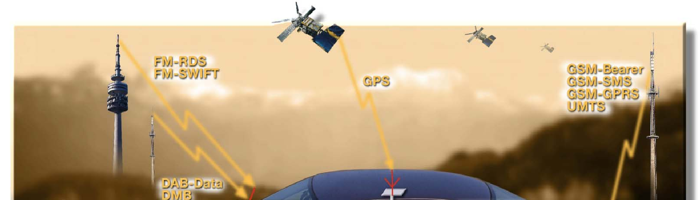
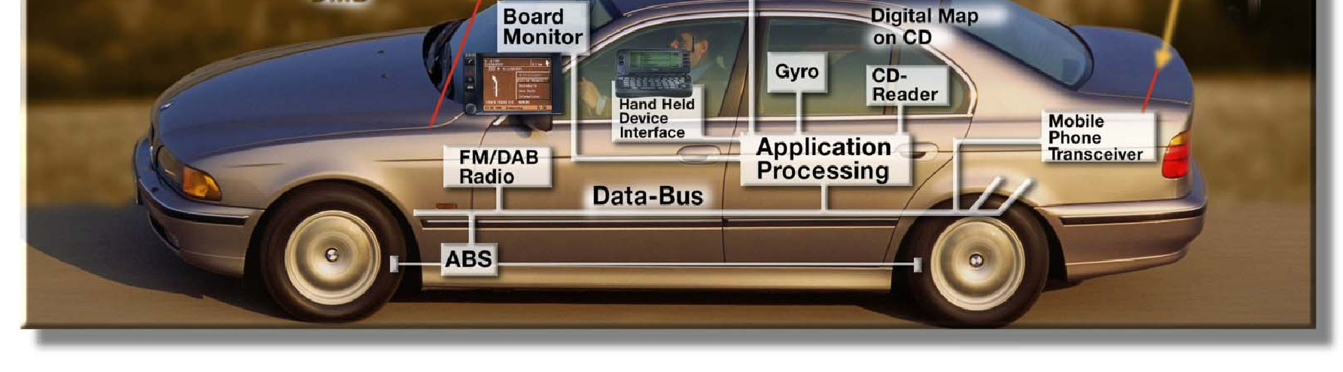
Automotive Electronics
EE185524 2022E – 1

Slide 18
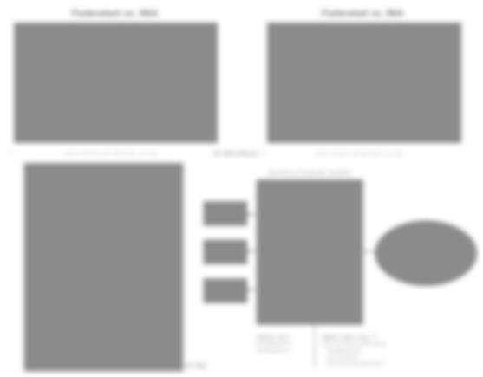
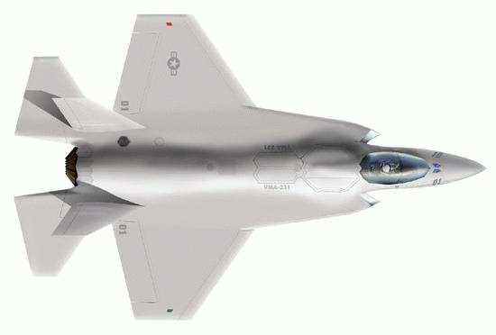
Avionics
Federated vs. IMA
Federated vs. IMA
Flight Controls Flight Management
Inertial Reference System
Displays Navigation Computer
Mission Computer
Flight Controls Flight Management
Inertial Reference System
Displays Navigation Computer
Mission Computer
Engine Controls Engine Monitoring Fire Control
Weapons Control Stores Management Targeting Computer
Radar Sensor systems
FLIR EO/OP
Engine Controls Engine Monitoring Fire Control
Weapons Control Stores Management Targeting Computer
Radar Sensor systems
FLIR EO/OP
7
Courtesy of © Wind River Inc. 2008 – IEEE-CS Seminar – June 4th, 2008
[© Wind River] ⁸
Courtesy of © Wind River Inc. 2008 – IEEE-CS Seminar – June 4th, 2008
Azimuth data
Twisted-pair copper wire
Avionics Computer System
Transmitter
Receiver
Receiver
Receiver
Avionics Subsystem Partition 1
End System
Inertial Platform
Autopilot
Heads-up Display
Other Systems, etc.
Controllers
Simplex
100 Kbps (maximum) Up to 20 receivers
Avionics Subsystem Partition 2
AFDX
Switch
ARINC 429
Sensors
AFDX
Network
Switch
Two pairs category 5 UTP twisted-pair copper wire
Actuators
Avionics Subsystem Partition 3
End System
End System
End System
Inertial Platform
Heads-up Display
Other Systems, etc.
ARINC 653
Sampling ports
Queuing ports
ARINC 664, Part 7
AFDX communications ports
Sampling ports Queuing ports
Service access point port
Full duplex
100 Mbps (maximum) Number of connections governed by number
of switch ports
AFDX
[© GE]
EE185524 2022E – 1

Slide 19
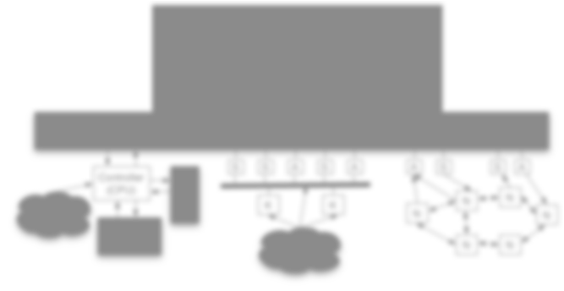
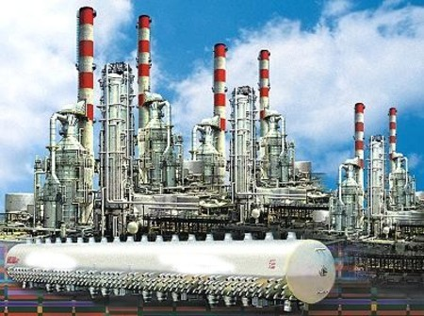








Variety of control system architectures
Plant Network
Controller (CPU)
S
S
A
S
A
A
S
S A
Plant 3
N
N
K
K
N
Scheduler
N
Plant 2
Schedulers
N
N
EE185524 2022E – 1

Slide 20
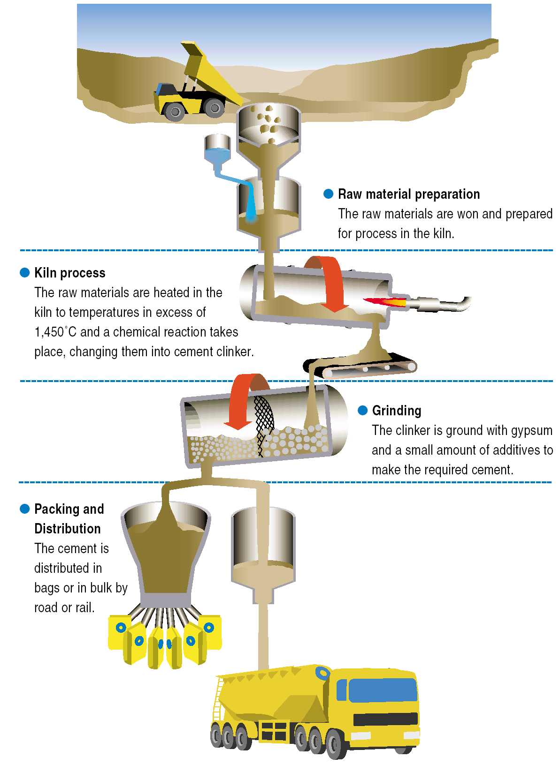
EE185524 2022E – 1

Slide 21
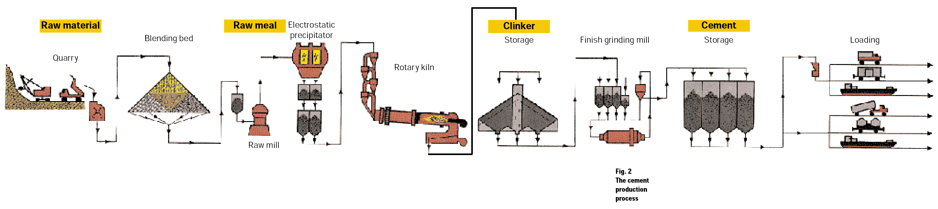
EE185524 2022E – 1

Slide 22
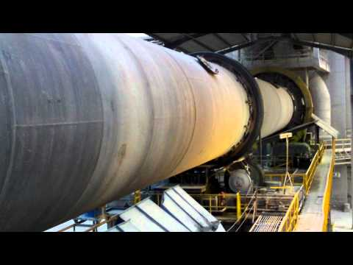
EE185524 2022E – 1

